Slide 1

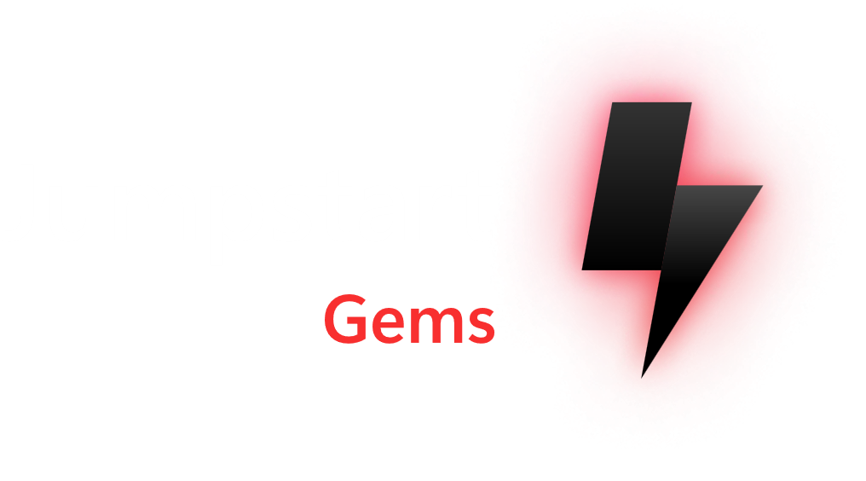


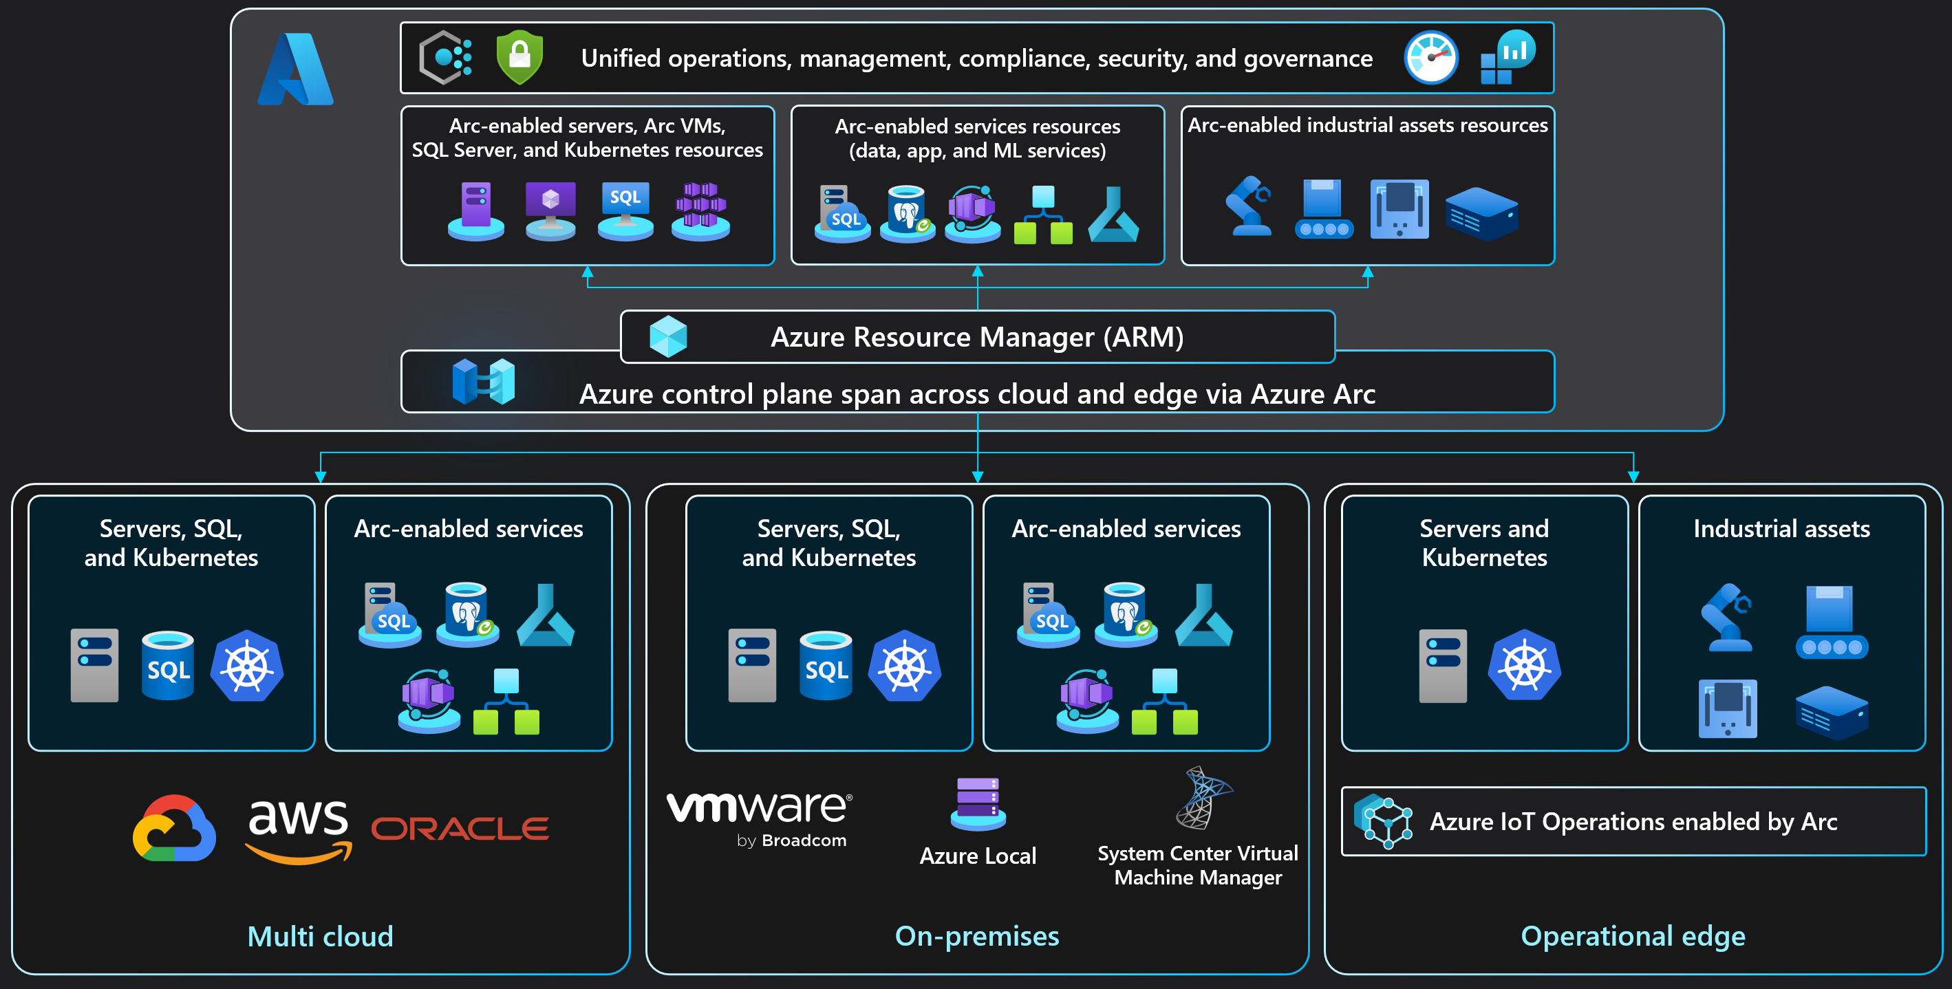
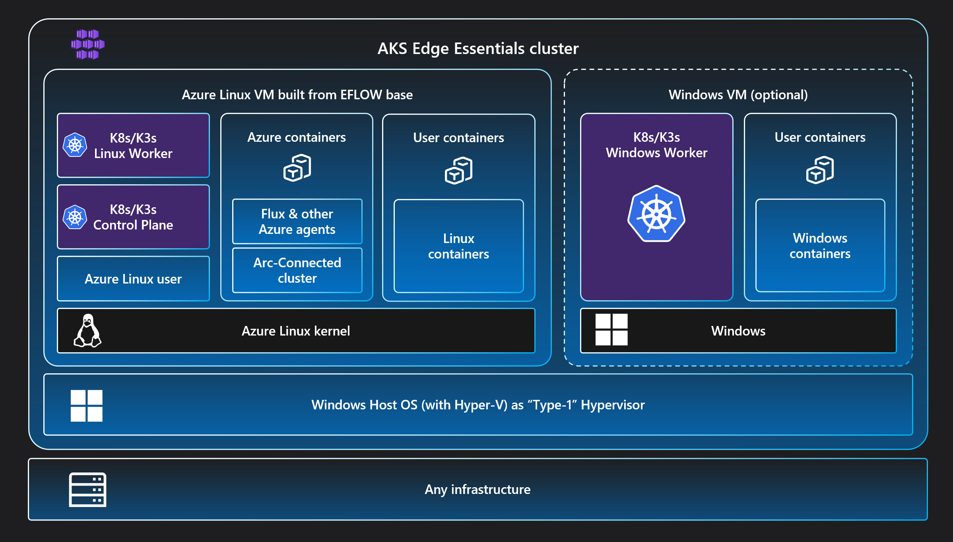
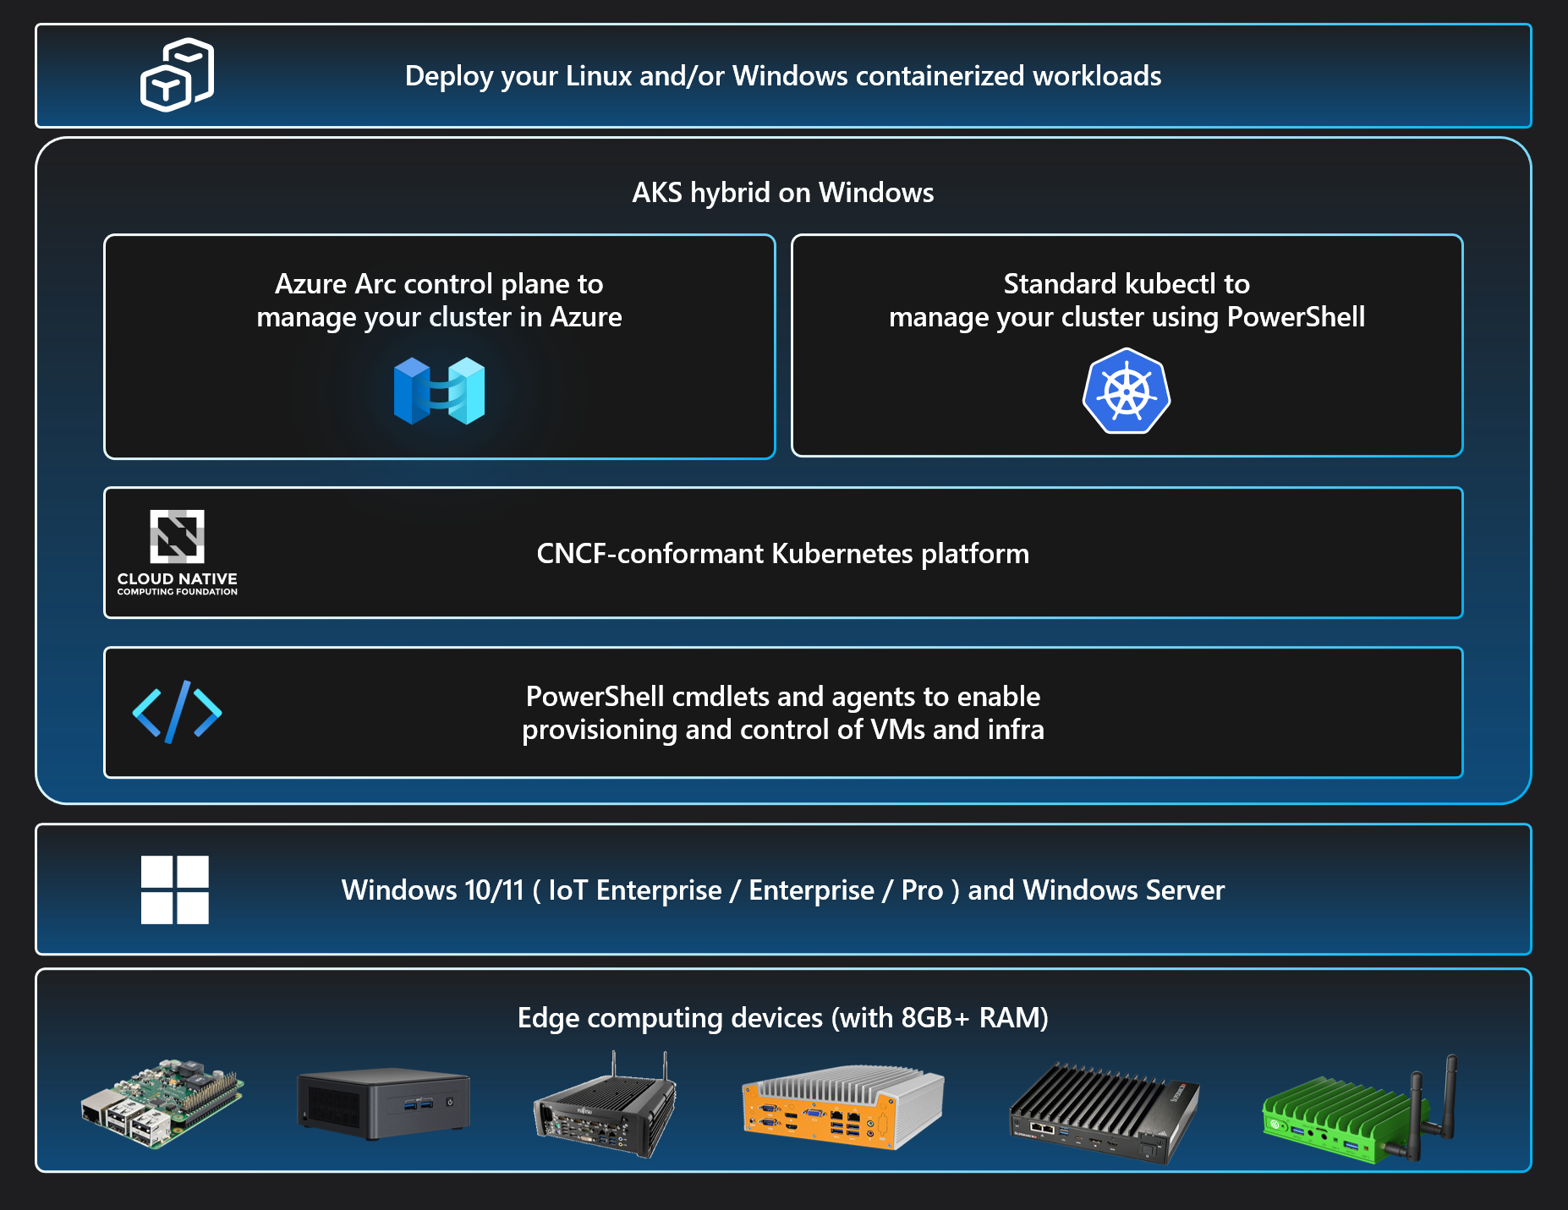
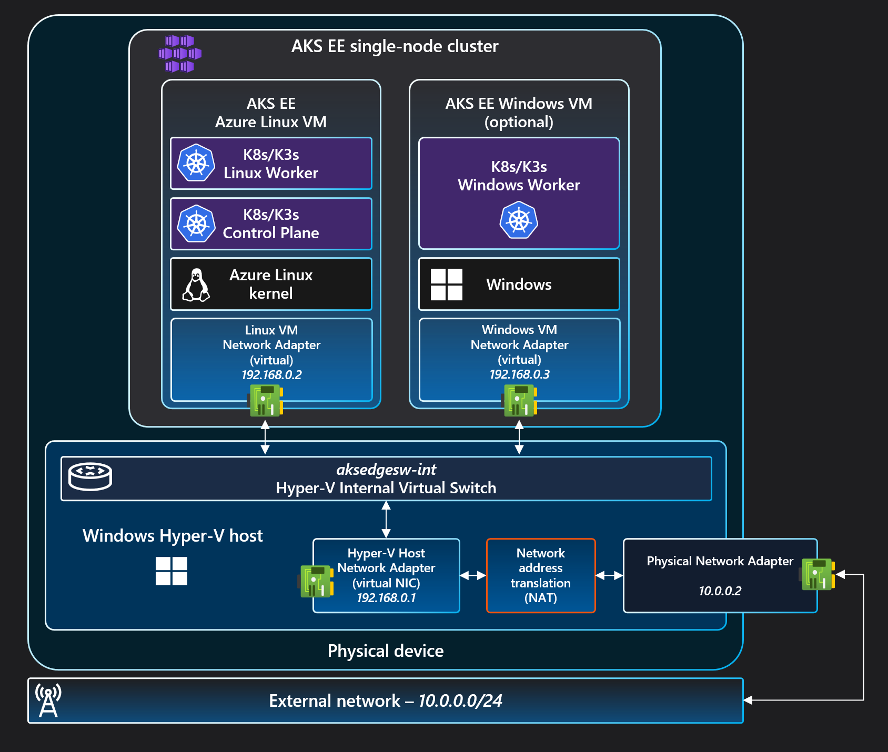
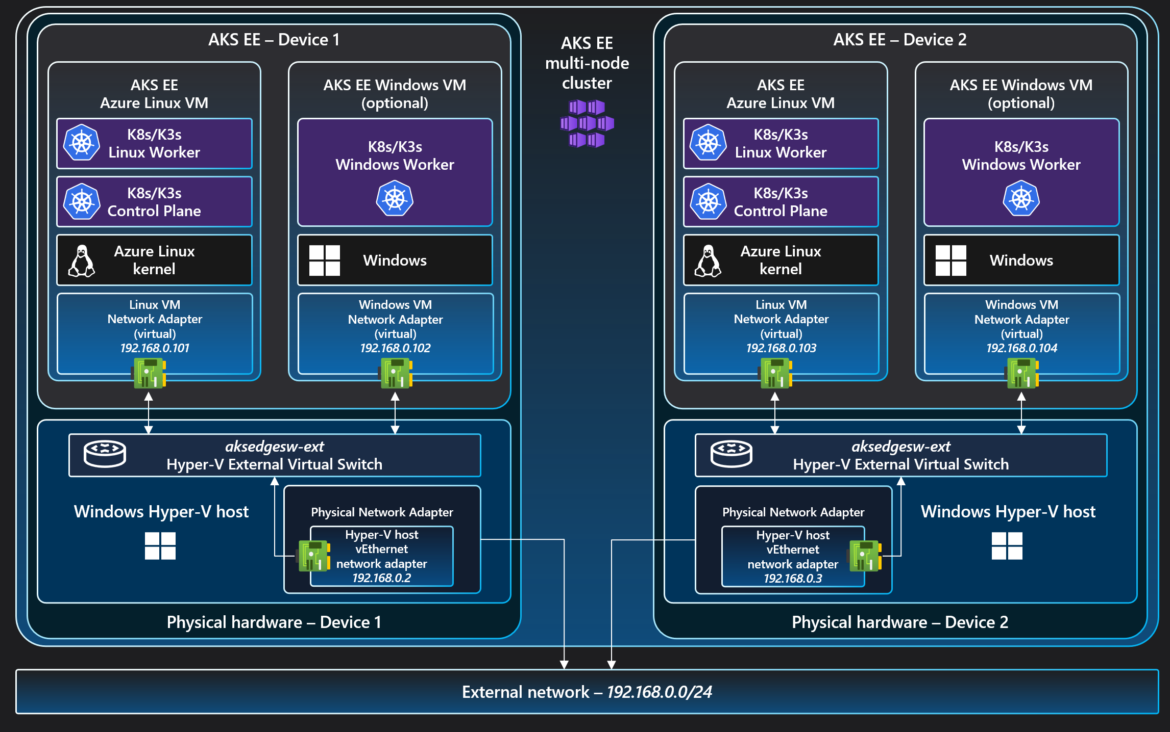
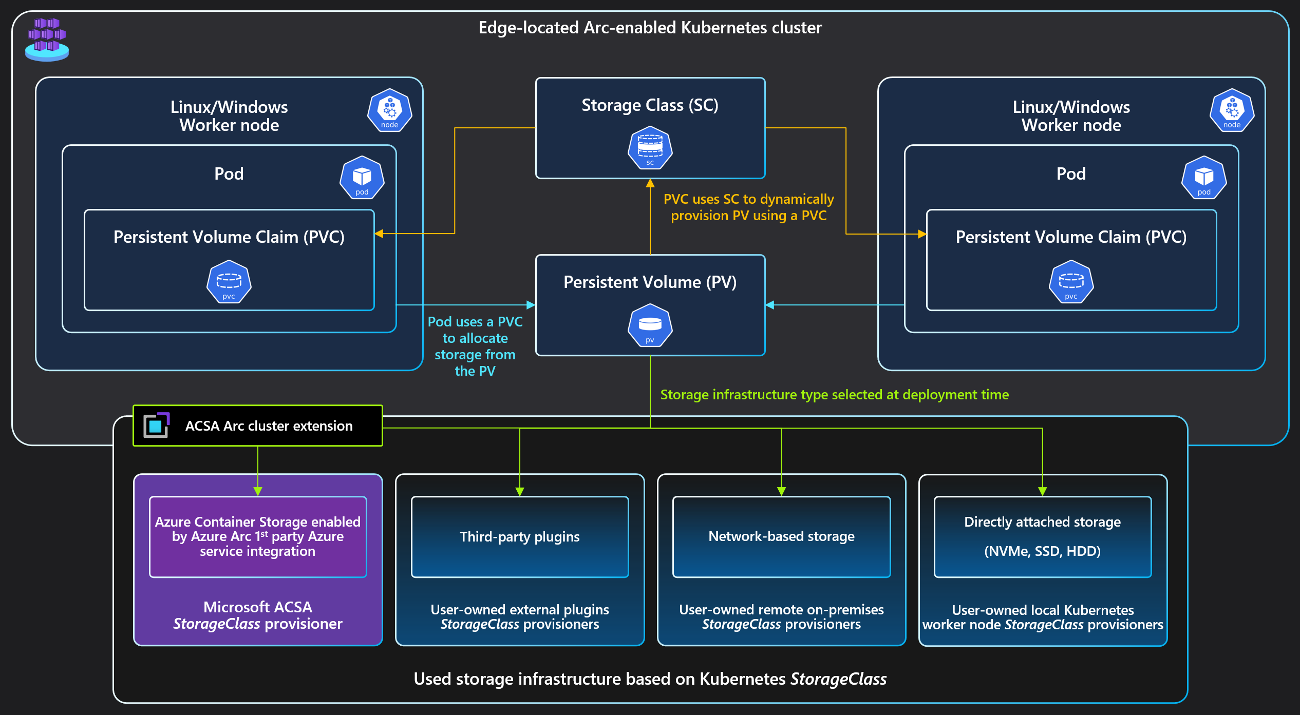

AKS Edge Essentials
Azure Arc solution architecture
Solution architecture
Deployment options on Windows
AKS EE single-node cluster with internal virtual switch network architecture
AKS EE multi-machine cluster with external virtual switch network architecture
AKS EE storage options architecture
Copyright @ 2025 Microsoft. All rights reserved. v1.6 #ArcJumpstart | aka.ms/JumpstartGems

